Slide 1



Macrosystems EDDIE: Teleconnections
Farrell, K.J. and C.C. Carey. 18 May 2018.
Macrosystems EDDIE: Teleconnections.
Macrosystems EDDIE Module 3, Version 1.
http://module3.macrosystemseddie.org
Module development was supported by NSF EF 1702506.
Notes:
Welcome the students to class. It might be helpful to go around the room and briefly discuss if anyone has experience programming or modeling. The point of this is to emphasize that most students are likely novices, and that asking lots of questions is ok because their peers are novices as well.
It is really important at this point to emphasize that there will be lots of new material covered during this module, and that going slowly and asking for help is very much encouraged!
We generally try to organize the classroom so that students with similar operating systems (e.g., Mac vs PC) can work together; this module asks students to work in pairs.

Slide 2
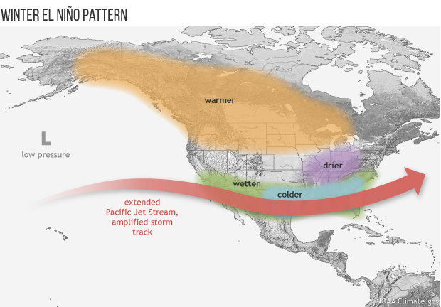
Plan for today:
Short overview on teleconnections and their effects on lakes, and how we can use a macrosystems ecology and lake modeling approach to understand this phenomenon!
Activity A: Run and explore a whole-lake simulation model in R
Activity B: Use long-term data to simulate two different El Niño climate scenarios, generate hypotheses, and model how different lakes respond
Activity C: Discuss how the strength of global El Niño teleconnections varies among different lakes locally and regionally in altering lake temperature and ice cover
Image: NOAA
Notes:
Quick road map of what will be covered in the PowerPoint; be sure to point out that the figure shows how El Nino patterns can be mediated by geographical location on the continental scale.

Slide 3
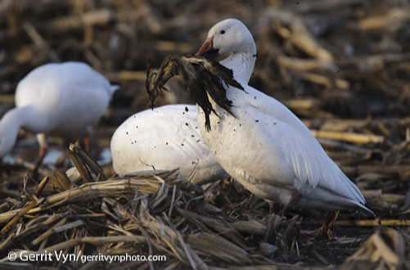
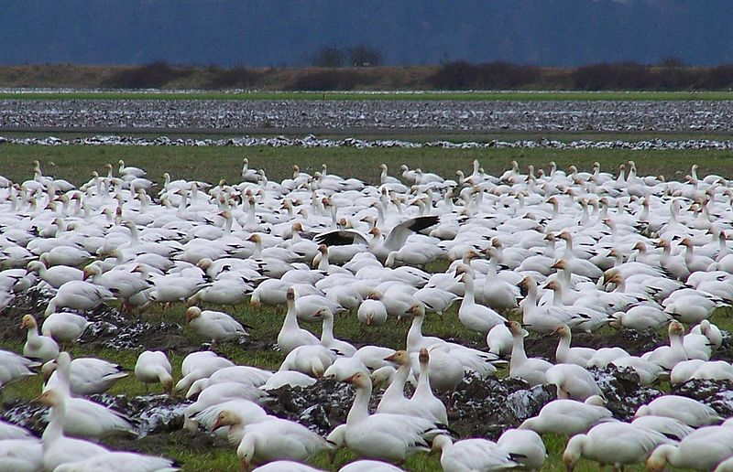
What are teleconnections?
Teleconnection: a phenomenon that links remote regions via cause and effect relationships
Ecosystems can be influenced by climatic, societal, economic, and/or ecological changes in distant regions through teleconnections
Agricultural fields in the midwestern United States provide food for overwintering snow geese
Additional food has lead to rapid population growth, with negative effects for arctic marshes where the geese spend the summer
Image: birdsna.org
Image: Wikimedia Commons
Notes:
Teleconnections refer to phenomena that link remote regions through cause and effect relationships.
It's important to highlight that teleconnections can be ecological, climatic, economic, etc.
An example of a teleconnection that touches on societal/economic and ecological drivers and responses is how agricultural fields in the midwestern U.S. can provide food for overwintering snow geese, as they feed on crop residues that remain on the fields after harvest. This food helps snow geese maintain high body condition, and after they migrate north for the summer, they are able to lay and hatch more chicks. The higher populations of snow geese in turn lead to overgrazing of the subarctic marsh ecosystem during the summer. This connection between midwestern farms and subarctic marsh via snow geese is a teleconnection.

Slide 4
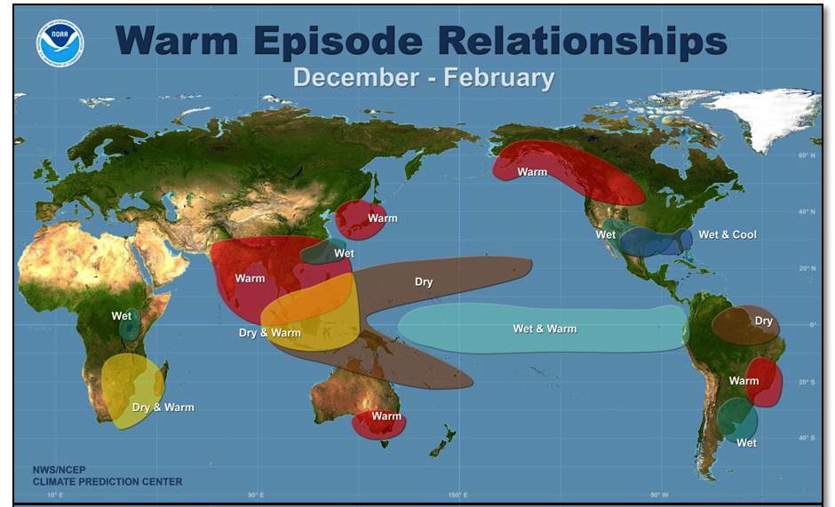
El Niño/Southern Oscillation (ENSO) Teleconnection
A climate phenomenon in the tropical Pacific Ocean where ocean surface temperatures are warmer than average
Warmer ocean temperatures affect atmospheric circulation, air temperatures, and precipitation worldwide but in different ways based on your region!

Slide 5
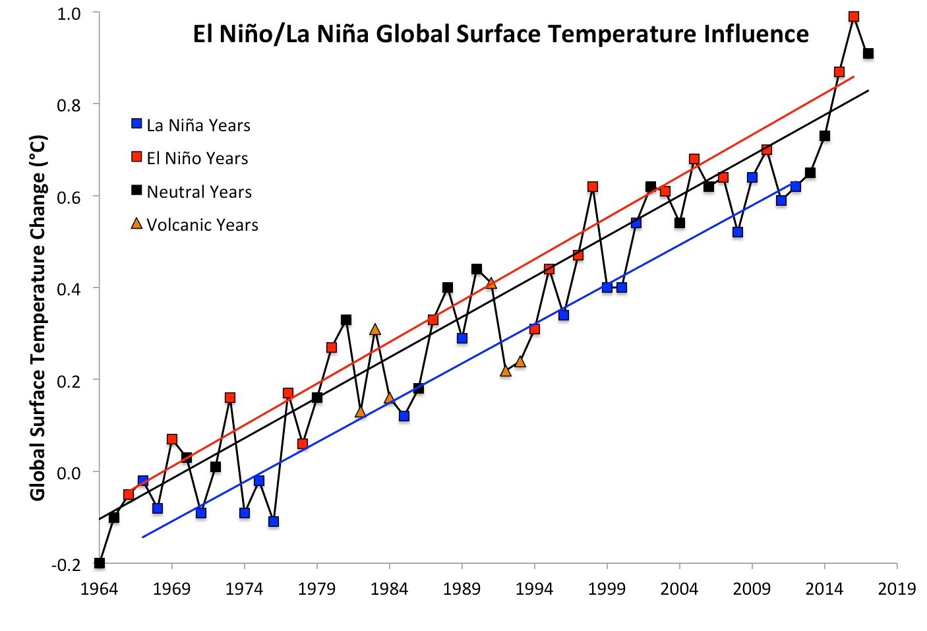
Global land surface temperatures typically warmer in El Niño years: but what about lakes?
Figure: Dana Nuccitelli via www.theguardian.com
Notes:
Land surface temperatures are generally warmer, but little is known about how El Nino forcing affects lakes- given their thermal inertia, do they show any response to these teleconnections?

Slide 6
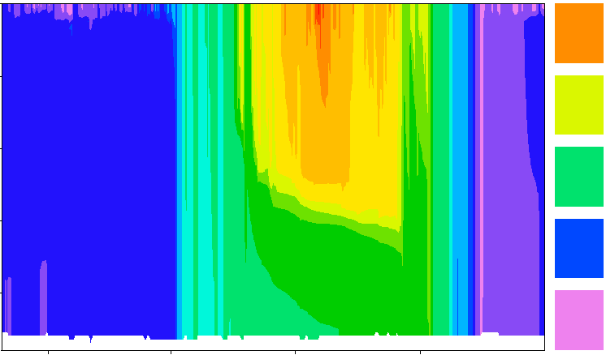
How does lake temperature vary seasonally?
0
Ice cover
20
2
Epilimnion
Depth (m)
Temperature (°C)
15
4
10
6
Thermocline
5
8
Changing lake level
Hypolimnion
0
Jan.
2013
Apr.
2013
Jul.
2013
Oct.
2013
Lake Sunapee, NH, USA: data from Lake Sunapee Protective Association buoy
Notes:
Here are lake temperature data from Lake Sunapee, a large dimictic lake in New Hampshire, USA, from 2012.
Tell the students how time is on the x-axis, and depth is on the y-axis (from the surface to the sediments at 9 m depth), with color referring to the temperature, from cold 0ºC (blue) to very warm 30ºC (red). These are called heat maps or thermal plots, and we will be these types of figures in the module.
When we say ‘lake thermal structure,’ we are referring to both the magnitude of the water temperature in the lake at multiple depths, as well as the stratification pattern.
If a lake is thermally stratified, it exhibits distinct layers of water on a density gradient. In the summer, warmer water on top is less dense than colder water on bottom. Maximum density of water is at ~4ºC: water at 25ºC is substantially less dense than colder water, hence why it is at the surface of the lake.
Note! We are focusing here on thermal stratification, not chemical stratification. Density gradients due to differences in water chemistry (e.g., salinity) can be a major factor altering stratification in some lakes, but we are focusing on thermal density gradients in this module.
We are now going to introduce some terminology:
The epilimnion encompasses the zone of the lake from the surface down to the thermocline, or the depth of maximum temperature change.
The hypolimnion is the lake zone below the thermocline.

Slide 7
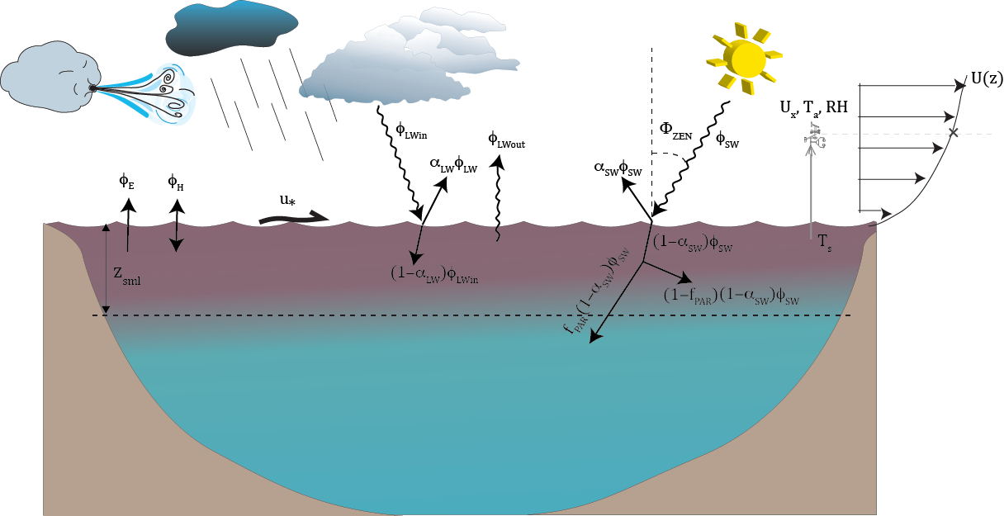
What are the drivers of water temperature?
Solar radiation
Air temperature
Wind
Precipitation
Inflow & outflow streams
All of these factors will interact to control water temperature, ice cover, and more!
Figure: Hipsey et al. 2014
Notes:
Water temperature is regulated by several factors, including, solar radiation, air temperature, wind, precipitation, and inflow/outflow streams.
All of these will interact to control water temperature, ice cover, and thermal structure. The depth of the thermocline is regulated by solar radiation and wind-driven mixing. These factors can also contribute to lake depth, or level, through changes in evaporation, precipitation, and surface flows.

Slide 8
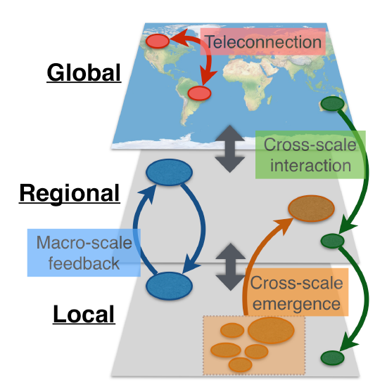
Using a macrosystems ecology approach to study the effect of ENSO on lakes
Drivers of water temperature occur at local, regional, and continental scales
Local = e.g., inflow streams
Regional = e.g., weather patterns
Global = e.g., El Niño forcing
Macrosystems ecologists study ecological dynamics and feedbacks at multiple interacting spatial and temporal scales
We can study local, regional, and global drivers using high frequency sensor data + simulation models
Figure modified from: Heffernan et al. 2014
Notes:
Drivers of lake temperature can occur at local, regional, and global scales: e.g., the temperature of inflowing streams and groundwater are local factors, whereas weather/climate patterns tend to be regional or global.
Looking at the effects of drivers operating at multiple scales uses a macrosystems ecology approach, which entails studying ecological dynamics and feedbacks across multiple spatial and temporal scales.
Here, we are using a macrosystems approach combining high-frequency sensor data and simulation models to compare the effects of local and regional drivers on lake temperature and ice cover

Slide 9
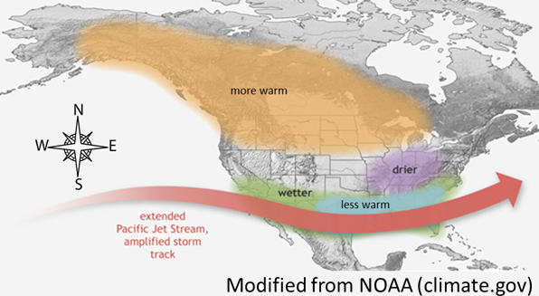
El Niño effects on air temperatures vary regionally; can we detect this pattern in lakes?
In the U.S., the greatest increases in warm weather are on the west coast and in the midwest
On the east coast and in the south, temperatures do not increase as much during El Niño years

Slide 10
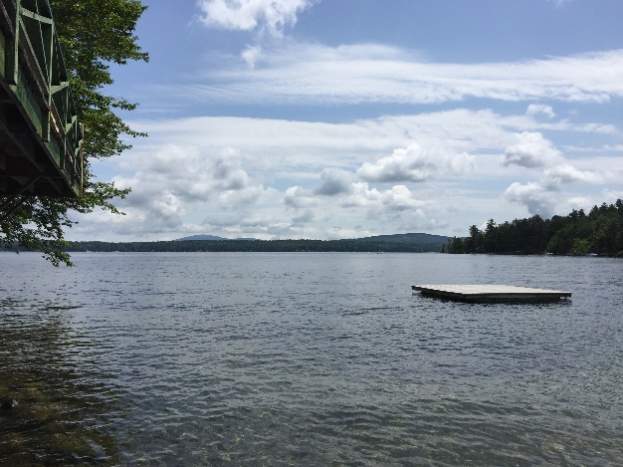
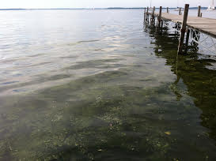
Teleconnections in lakes
Lake temperatures and ice cover duration are likely affected by ENSO events, but little is known about lake responses
The effect of El Niño on a lake may depend on the strength of the El Niño forcing itself, the region in which a lake is located, and local lake characteristics
Today, we’re going to examine how the effects of El Niño teleconnections on lakes across the U.S. are mediated by local and regional factors
C.C. Carey
C.C. Carey

Slide 11
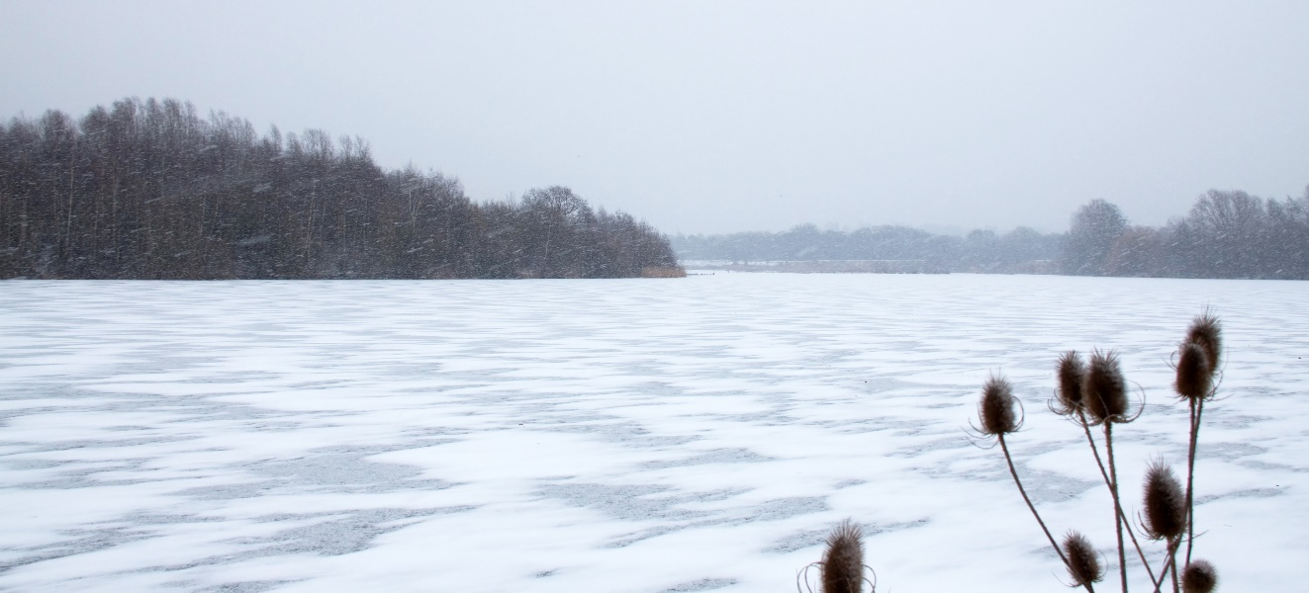
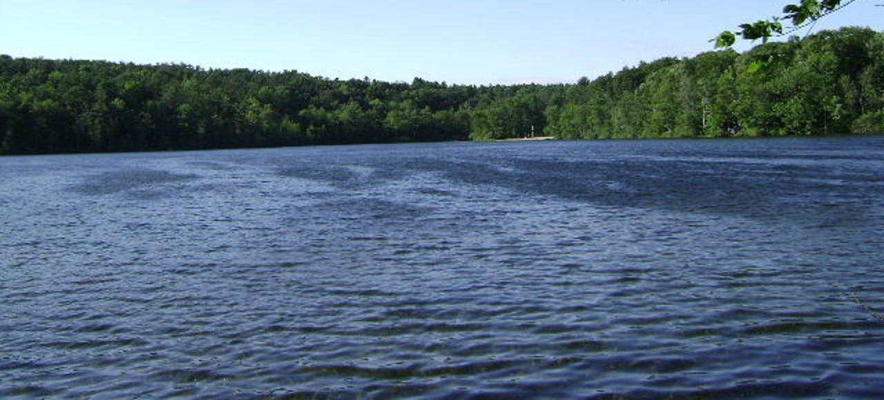
Why studying ENSO effects on lakes matters:
Even warming of just 1ºC due to ENSO can have substantial effects on lake thermal stratification, oxygen concentrations, nutrient cycling, algal blooms, and fish habitat
These changes can propagate over time: e.g., as lakes lose ice in warmer winters, they absorb more heat, resulting in warmer summer water temperatures
Image: Wikimedia commons
Image: Wikimedia commons

Slide 12
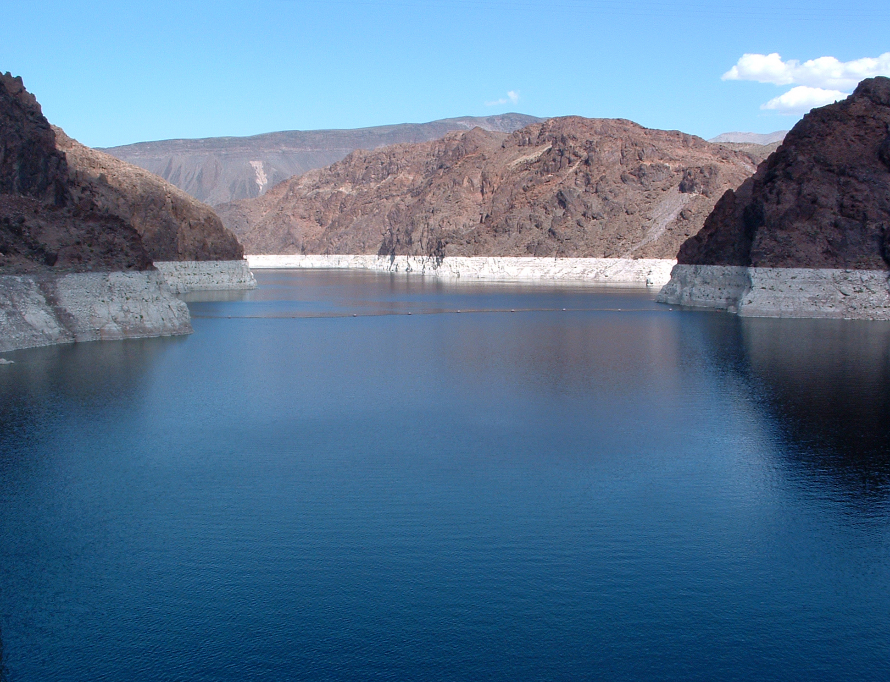
Our focal question:
How do global ENSO teleconnections interact with local and regional characteristics to
affect lake temperatures and ice cover?
Image: Wikimedia Commons

Slide 13


Models to identify drivers across scales
How can we test the effects of remote drivers on lake temperatures and ice cover?
Impossible to experimentally manipulate climate drivers in lakes across a continent!
Simulation modeling allows us to explore how different lakes respond to a change in one or more drivers:
For example, how would lake temperatures and ice cover change across the continent in response to an El Niño year?
-2°C
-2°C
+2°C
Notes:
To study the effects of drivers across scales, researchers use models, because it is impossible to manipulate factors such as solar radiation, air temperatures, and inflowing streamwater temperatures on real-world lakes at the whole-lake scale in a controlled way.
However, simulation modeling allows us to test how changes in drivers alter lake temperatures and ice cover. Simulation models allow us to manipulate weather to simulate an El Nino event, and to test how the response of lake temperature to an El Nino event differs across multiple lakes.

Slide 14


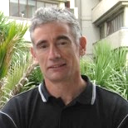
GLM: General Lake Model
The General Lake Model (GLM) is an open-access model for simulating lake dynamics
GLM simulates vertical stratification and mixing and accounts for the effect of inflows/outflows, surface heating and cooling
GLM has been designed to be an open-source community model developed in collaboration with members of the Global Lake Ecological Observatory Network (GLEON) to integrate with lake sensor data
Authors: Matt Hipsey, Louise Bruce, and David Hamilton
http://aed.see.uwa.edu.au/research/models/GLM/
Notes:
The simulation model we are going to use is GLM (the General Lake Model), which we can use to simulate changes in lake stratification, mixing, and surface heating and cooling.
GLM was developed in 2012 as an open-source model by researchers in GLEON, the Global Lakes Ecological Observatory Network.

Slide 15
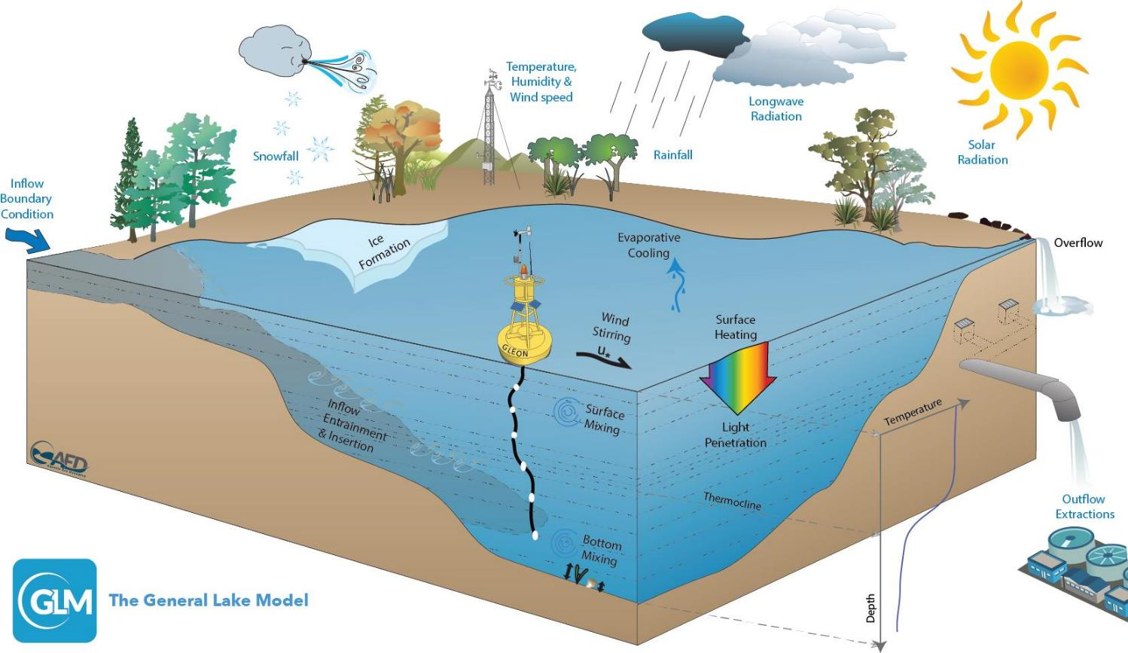
Figure: Hipsey et al. 2014
Notes:
GLM is a lake physics model, which uses climate forcing data as input (e.g., inflows, snow, wind, temperature, humidity, radiation) and models lake thermal structure, with lake temperature profiles as output.

Slide 16
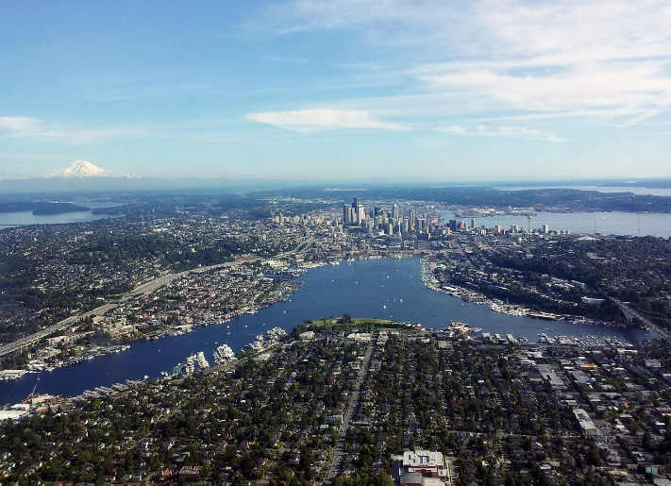
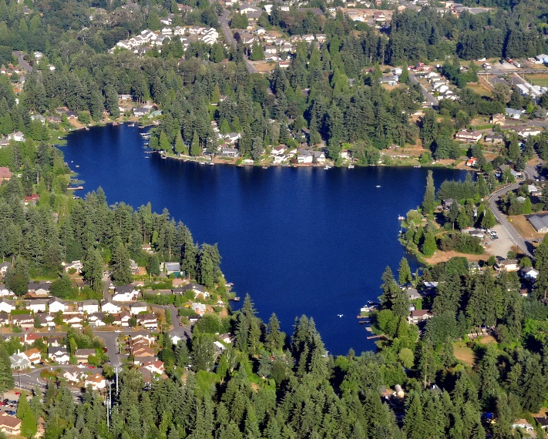
Basic structure of the model
You have downloaded all the necessary files to run GLM in the Macrosystems EDDIE "teleconnections" folder
Within this folder, you will have:
A meteorological CSV (‘met’) file that forces the model (met_hourly.csv)
An ‘nml’ text file that acts as ‘master’ scripts for the model (glm2.nml)
Inflow/outflow CSV files that specify the temperature and flow rate of connected streams entering and leaving the lake (if you lake has surface inflows and outflows!)
Images: Wikimedia commons
Notes:
GLM requires a separate folder/directory on each student’s laptop, which will be downloaded as an RStudio project.
Within this folder will be:
1) A CSV (comma-separated values) file that has the climate driver data (also referred to as a ‘met’ file; or a file with the meteorological data. We call this ’met_hourly.CSV’),
2) An .nml file, which can be opened as a text file, and acts as a master script to the GLM model (it contains parameters for how the model should work, and tells the model basic information about the lake, such as depth, latitude, time period of the simulation, etc.), and
3) inflow/outflow CSV files that specify the temperature and flow rate of the connected streams entering and leaving the lake (if applicable!). Note that some lakes we'll model today have surface water inflows and outflows, and some are not– they are groundwater fed.

Slide 17
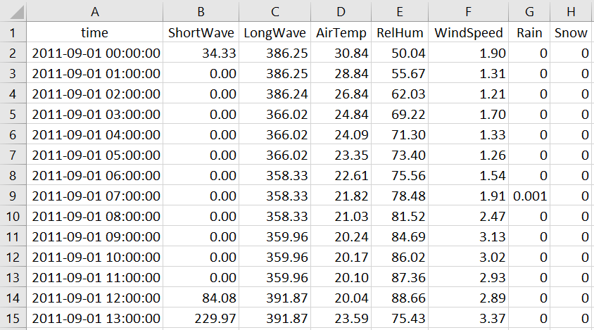
Example met file
Notes:
Here is an example met file, with columns for time step, shortwave radiation, longwave radiation, air temperature, relative humidity, wind speed, rain, and snow.
This met file is on an hourly time step.
For our El Nino scenarios today, we’ll be changing ONLY the AirTemp column, to see how changes in air temperature affect lake water temperatures. Note to instructors: to examine other meteorological variables, we encourage you to check out Macrosystems EDDIE module #1 (Climate change effects on lake temperatures), which involves manipulating many variables simultaneously.
Note the DateTime structure of the time column: GLM requires this exact format of YYYY-MM-DD hh:mm:ss. GLM also requires that the column headers are spelled exactly like what is in this file (and are capitalization-specific). This is not the default format of Excel, so it requires you to manually edit the time-date format of this column if you open the file in Excel. Luckily, we will be using R scripts to modify our met files for the different El Nino scenarios, so we won't have to open Excel to change these files!

Slide 18
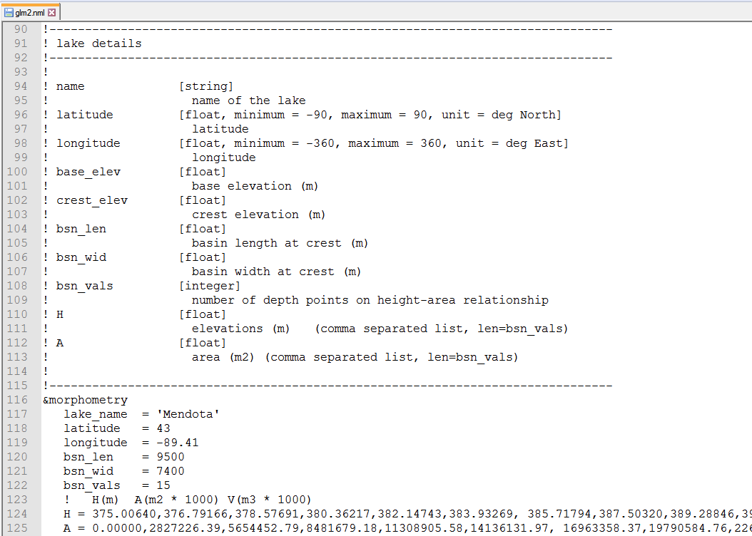
Example .nml file
Notes:
Here is an example .nml file, which goes through many required pieces of information, such as what the name of the lake being modeled is, its latitude/longitude, the time period being modeled, etc. You can open up an .nml file in a text editor program or through RStudio to make changes.
Fun fact: nml stands for “namelist” in the Fortran programming language.

Slide 19
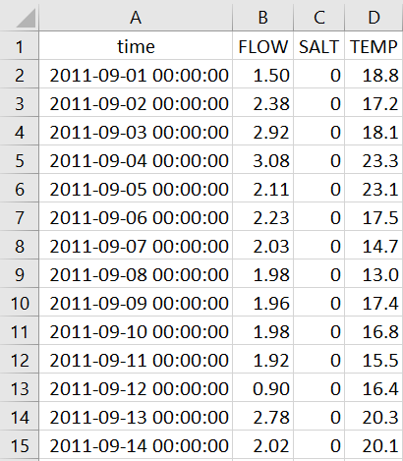
Example inflow file (for lakes with inflows)
Notes:
Here is an example inflow file, with columns for time step, water volume (FLOW), salt concentration, and water temperature. This inflow file is on a daily time step.
Note that the time column in this file needs to be in the exact same format as the met file; YYYY-MM-DD hh:mm:ss. Again, you’ll need to manually edit the time-date format of this column if you open the file in Excel.

Slide 20

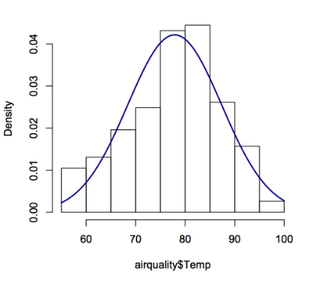
We will run GLM using R
R is a statistical environment that can run on different computer operating systems (PC, Mac, Linux)
R is reproducible, free(!), and easy to download
R can run stats, make figures, and do a suite of different analyses in many disciplines
Many packages for R to merge with other tools (including GLM!)
We’ll walk you through each step of the script, so don’t worry if you’re new to R!
Notes:
We are going to run GLM in R, a programming language and statistical environment that is used for running statistics, making figures, and doing lots of different analyses.
Within R, you can download lots of different software ‘packages’ for different types of analyses.
A major benefit of R is that it is free, runs on all operating systems, and is reproducible- i.e., any code that you write can be saved and run later, and you know exactly what you did!
R is the preferred programming language of many ecologists and provides a great entry level language for learning some basic coding skills that are used in many different career paths.

Slide 21
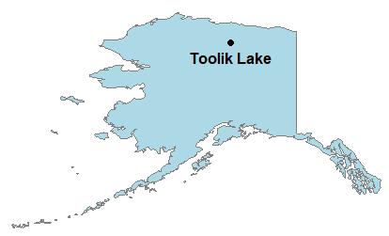


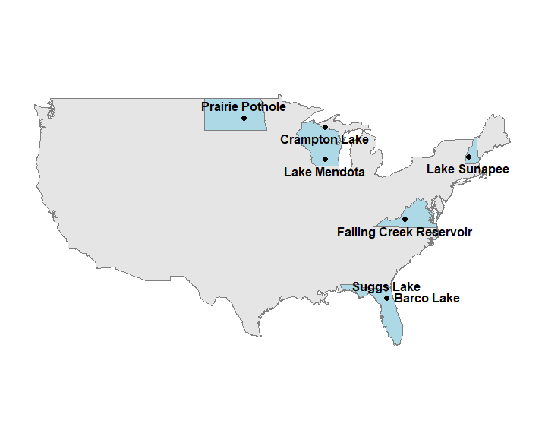

Lakes we’re going to model today, using a suite of available continental datasets
GLEON.org
engr.wisc.edu
Notes:
Our module today will involve modeling multiple lakes across the United States. We are excited to have lakes from a number of distinct ecoregions. Many of these lakes are part of the National Ecological Observatory Network, or NEON, which is a continental-scale ecological observation facility that is collecting long-term and high-frequency ecological data from many ecosystems– including lakes! Our models also use data from lakes that are part of the Global Lake Ecological Observatory Network, and climate data provided through the National Oceanic and Atmospheric Administration, NOAA.

Slide 22
Learning objectives
Understand the concepts of macrosystems ecology and teleconnections, and how different ecological processes can interact at local, regional, and global scales
Set up and run ecosystem models to simulate lake temperatures and ice cover in multiple lakes (Activity A)
Test the effects of teleconnected climate scenarios on the different lake models, and examine how local characteristics modify global-scale climate forcing effects on lake temperatures and ice cover (Activity B)
Compare the role of teleconnections in driving lake temperatures and ice cover across multiple lakes in different regions (Activity C)
Predict how lake temperatures and ice cover may respond to changes in the timing and intensity of global-scale meteorological phenomena (Activity C)
Notes:
Learning objectives!
Talk through these with the students one by one: use the embedded animations to sequentially show each of the bullet points.
Most importantly, the goal here is to have students develop hypotheses for how teleconnections will affect different lakes, and then test their hypotheses by creating different El Nino scenarios and forcing the lakes with those scenarios.
They will make mini-presentations to share their model findings with the class as part of Activity C, and we recommend also having a whole-class discussion to synthesize patterns observed across the different lakes.
A major goal is to compare how different lakes respond to the same teleconnection– in this case, the El Nino Southern Oscillation.

Slide 23

Discussion questions embedded in your
handout
Everyone will turn in the completed handout with question answers written out at the end of the module today.
We encourage you to work with your partner to complete the questions!
Image: newsfrom4j.wikispaces.com
Notes:
On your handout, there are questions for each section of the module. As you work through the module, be sure you’re writing down answers to each of the questions, as you’ll be turning these worksheets in at the end of class!
Note to instructors: these could also be collected as homework, depending on the class’ experience level and which activities you plan to cover.

Slide 24
A few important notes about R
Lines of code that start with # are not read by R
These lines include important notes about how and why the R script is running, so be sure you’re reading them!
Lines with ##!! indicate lines of code where you need to modify something for it to run
In the glm2.nml file, ! indicates lines that are not read by the GLM model (tricky!)
When you need to modify your glm2.nml file in Activity B, make sure you’re not changing the value in a line that starts with a ! or your changes won’t be read by GLM

Slide 25
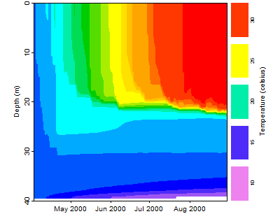
Activity A: Run a lake model!
With a partner (work in pairs):
Download the zipped folder of R scripts and other files to run this module from http://module3.macrosystemseddie.org. Unzip the folder to your Desktop
Install the GLM files and R packages onto your computer
Choose a lake! Look up your lake’s characteristics in the file provided
Run the GLM model for your lake and explore the output for lake temperature and ice cover under the baseline (non-El Niño) scenario
Notes:
Introduce Activity A.
Have students work in pairs as described earlier. Ideally, different student pairs will select different lakes so that the class covers as many distinct lakes as possible. You may want to have students write their group name and model lake up on the board to keep track.
After you’ve introduced the steps of Activity A, stop the PowerPoint and let the students get started on Activity A.

Slide 26
Activity B: El Niño scenarios
Using the long-term climate data provided for your lake, calculate how air temperatures for your model lake would change in a "typical" and a "strong" El Niño year compared to baseline (non-El Niño) conditions. Record your lake's "typical" and "strong" offsets (°C) on the board!!
Develop hypotheses about how changing air temperatures in the "typical" and "strong" offset scenarios affect lake temperatures and ice cover relative to baseline
Use R to create meteorological input files that reflect your lake’s El Niño offsets, and run the two El Niño scenarios ("typical" and "strong") for one year
Analyze the model output to determine how lake temperature and ice cover varied among the three scenarios (baseline, "typical" and "strong")
Create a few figures that examine your El Niño scenarios:
Does the model output support or contradict your hypotheses?
How does the model output differ between the baseline scenario, the "typical" El Niño, and the "strong" El Niño?
Notes:
Introduce Activity B:
In this section of the module, students will use the R script to estimate offsets for two different El Nino scenarios for their lakes, then use the script to create new meteorological driver files that correspond to their El Nino scenarios.
Students may have a hard time determining how much their lake temperatures and ice cover have changed in the individual scenarios, but should be able to distinguish changes among the three scenarios (baseline, "typical" El Nino, "strong" El Nino) with the plotting activity at the beginning of Activity C.

Slide 27
Activity C: Compare lake responses to El Niño
With your partner, compare your model outputs for the different scenarios to the NOAA map predictions, and explore lake characteristics that help interpret your lake's response to different El Niño scenarios
As a class, explore how the temperature offsets and lake responses differed among the lakes modeled by the class:
How do the temperature offsets for "typical" and "strong" El Niño scenarios differ among the model lakes based on their region?
Does the class’ model output support or contradict your hypotheses about which lakes would respond most strongly to El Niño scenarios?
Discuss:
What do the model outputs across multiple lakes tell us about how regional context mediates global teleconnections?
How might El Niño teleconnections affect lakes in regions we didn't model?
Notes:
Introduce Activity C:
The goal here is to have students compare how different modeled lakes responded differently (or the same) to the two El Nino scenarios.
We recommend having pairs of students share some graphs and figures from their model lake with the rest of the class, so that groups can see the range of responses encompassed by the different lake models.

Slide 28

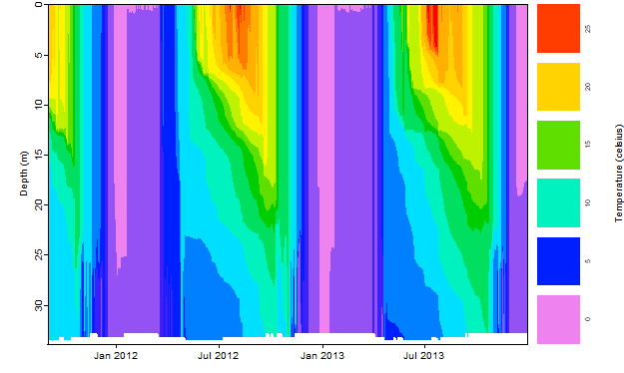
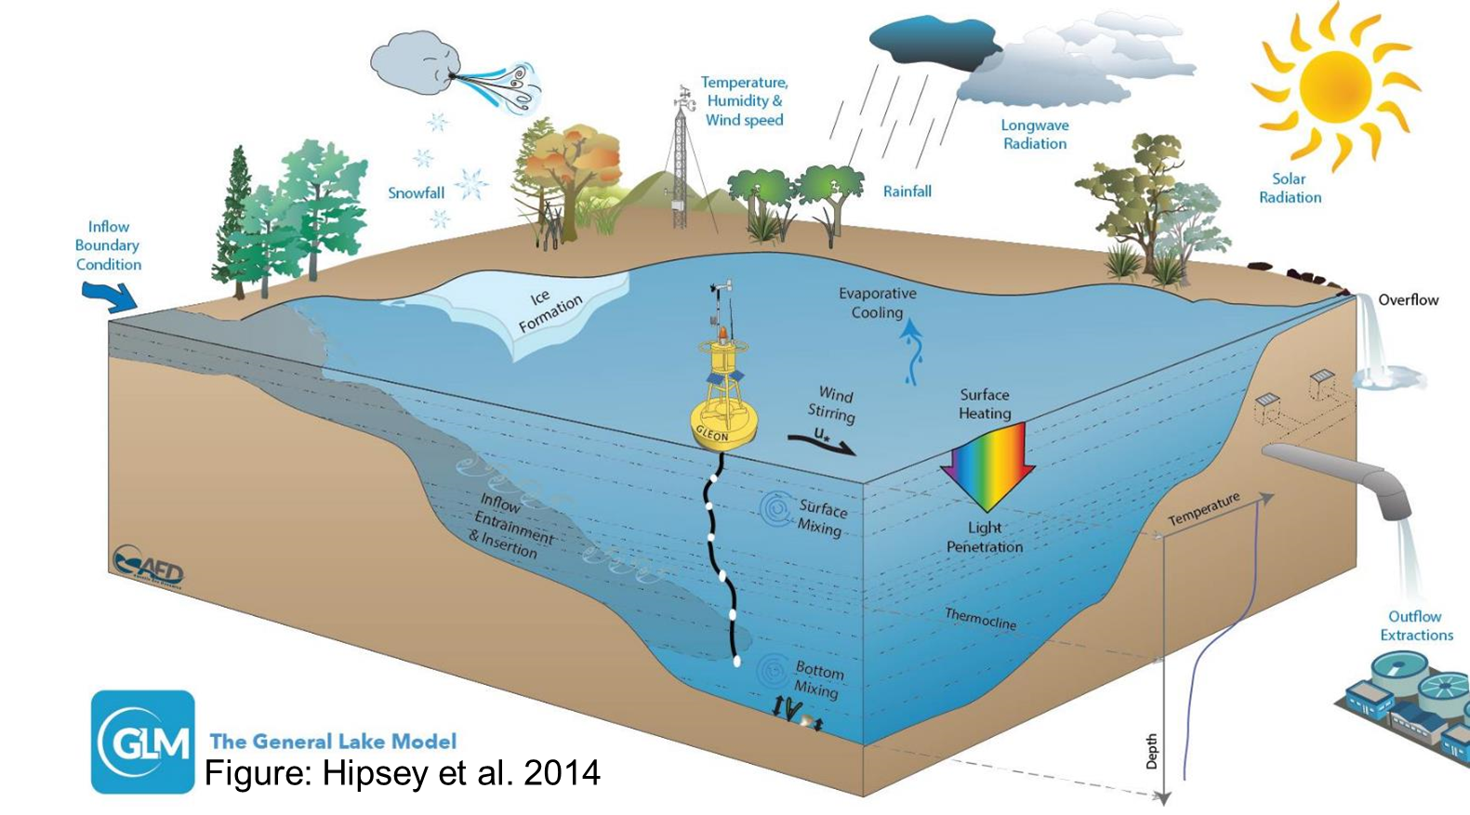
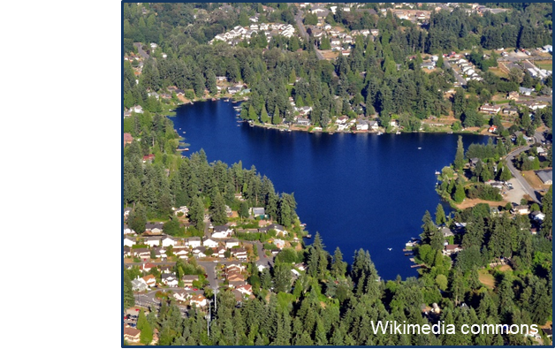
Thank you for participating!
Notes:
THANK YOU!

